Slide 1
Part III Application
Chapter 17
Reliability Estimation and Application
Mini-case Studies

Slide 2
Case 1: Redundancy
1. In order to determine the reliability seventy-five units were placed on test under a high stress environment. The test was terminated at the 50th failure with the following failure times (in hours) recorded.
0.4 0.8 0.8 1.9 2.0 Electronic component
2.2 2.4 2.7 3.1 3.2 Goal: R(4) = .90
3.6 3.9 4.0 4.0 4.3
5.7 6.0 6.3 6.5 6.8
8.3 10.1 11.1 11.4 11.5
11.7 11.8 12.4 12.7 13.1
15.0 15.4 17.6 17.8 18.3
18.7 18.9 19.4 19.6 19.8
21.0 21.5 21.6 22.2 22.8
24.1 25.1 25.6 25.8 26.0

Slide 3
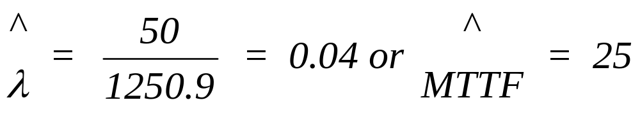
Case 1: Redundancy
2. A least-squares fit of the exponential distribution was
performed with the following result:
SLOPE - B 3.753863E-02
ESTIMATE MTTF 26.63923
CORRELATION .9920312
3. In order to perform a chi-square goodness-of-fit test,
the maximum likelihood estimator (MLE) was computed
from the sample of failure times.
T = 0.4 + 0.8 + 0.8 + … + 25.8 + 26.0 + ( 75 - 50 ) 26.0 = 1250.9

Slide 4
Case 1: Redundancy
4. The chi-square goodness-of-fit test was then conducted with
a = 0.10. The hypotheses are:
H0: Failure times are exponential with MTTF = 25 hours.
H1: Failure times are NOT exponential with MTTF = 25 hours.
For the chi-square test the data was grouped (somewhat
arbitrarily) into the following intervals:
Interval Frequency
0 - 5 15
5 - 10 6
10 - 15 9
15 - 20 10
20 - 26 10

Slide 5
Case 1: Redundancy
CHI-SQUARE STATISTIC FOR FITTING THE EXPONENTIAL
WITH A FAILURE RATE OF .04 OR MTTF OF 25
UPPER BND OBSERVED PROB EXPECTED (O-E)^2/E
5 15 .1812692 13.59519 .1451606
10 6 .1484107 11.13081 2.365073
15 9 .1215084 9.113127 1.404311E-03
20 10 .09948 7.461201 .8638689
26 10 .095874 7.190571 1.097673
INFINITY 25 .3534547 26.50911 8.590989E-02
TOTAL NBR OBSERVED 75
TOTAL NBR FAILURES 50
CHI-SQUARE STATISTIC 4.5591 < χ²_{crit,.10,4} = 7.779
DEGREES OF FREEDOM 4

Slide 6
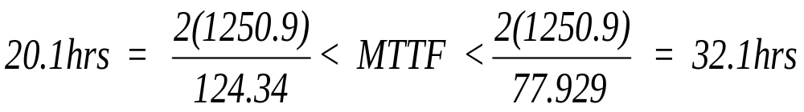
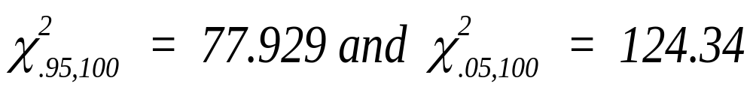
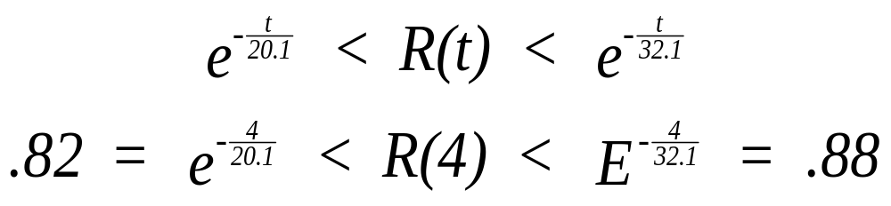
Case 1: Redundancy
5. Compute 90 percent CIs:

Slide 7
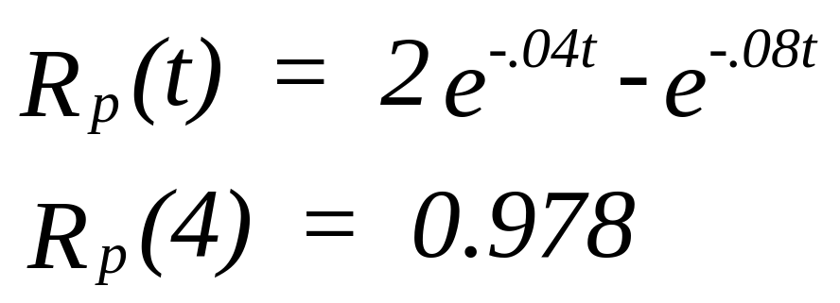
Case 1: Redundancy
6. Based upon the computed confidence interval, the 90
percent reliability for a 4 hour mission has not been achieved,
therefore a design modification must be considered in order to
meet the objective. As discussed earlier, redundancy was
considered to be the best design option. Two identical
redundant units provide the following reliability allowing
the contract specifications to be met:

Slide 8
Case 2: Burn-In Testing
A new fuel pump is experiencing manufacturing problems resulting in high infant mortality. The Company has a 25 operating hour warranty program which, because of the high infant mortality rate, is costing the company considerably. Each failure under the warranty program costs the company approximately $ 1200 in replacement costs, administrative
costs, and an estimated cost for the loss of "goodwill.“ They would like to implement a burn-in program in order to eliminate marginal pumps before they are sold under warranty. However, they are not sure whether a burn-in program will be effective, and, if so, how many hours of testing would be necessary to implement the program. To answer these questions, they first needed to establish an appropriate reliability model.

Slide 9
Case 2: Burn-In Testing
Twenty-five fuel pumps selected randomly from the
production line were placed on test. The test ran for 500
operating hours (Type I test). The following failure times
were obtained:
  0.005 0.1 0.2 1.0 1.0 2.3 9.3 10.1
  14.2 16.4 29.7 155.2 172.6 393.1 442.8 445.0
2. Assuming a decreasing failure rate, the Weibull distribution
was selected for analysis. A least-squares fit to the Weibull
was performed.
INTERCEPT - A -1.794813
SLOPE - B .2932619
ESTIMATED BETA .2932619
ESTIMATED THETA (Q) 454.9431
CORRELATION .9859856

Slide 10
Case 2: Burn-In Testing
3. The Mann goodness-of-fit test was run to statistically
test the hypotheses:
H0: Failure times are Weibull
H1: Failure times are NOT Weibull
NUMBER ON TEST 25
NUMBER OF FAILURES 16
VALUE OF K 9
NUMERATOR OF TEST 227.1296
DENOMINATOR OF TEST 155.3101
MANN'S TEST STATISTIC-M 1.462427
NUM DF FOR F CRITICAL 14
DENOM DF FOR F CRITICAL 16

Slide 11
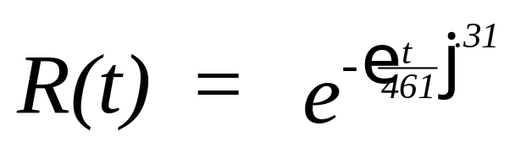
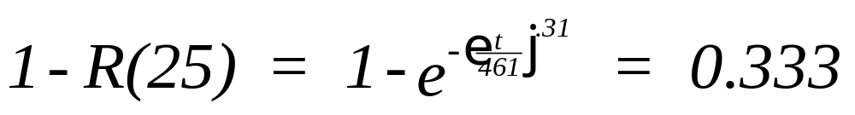
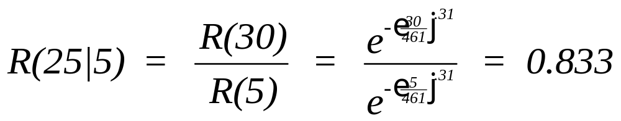
Case 2: Burn-In Testing
4. The parameters for the fitted Weibull were then
determined using the maximum likelihood estimators.
MLE FOR THE WEIBULL DISTRIBUTION
SAMPLE SIZE 25
NBR OF FAILURES 16
BETA (ß) 0.3134334
THETA (Q) 461.1464
5. The probability of a failure over the 25 hour warranty
period is found from:

Slide 12
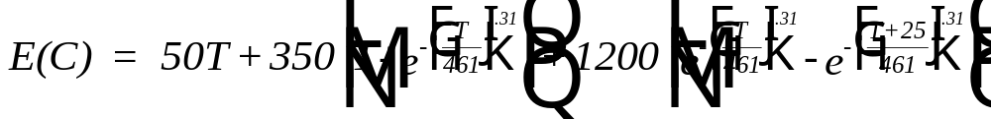
Case 2: Burn-In Testing
6. To determine the optimal length of time for burn-in testing,
an economic analysis was performed. The Company determined
that the cost of operating the program was $50 per unit tested
per hour and that a fuel pump which failed during testing
would incur its replacement cost of $350. The expected cost
model over the warranty life of the fuel pump is given

Slide 13
Case 2: Burn-In Testing
A direct search of the above equation at .1 hour intervals
resulted in the following:
T 0 .1 .2 .3 .4 .5 .6 .7 .8 .9 1.0
E(C) 399.7 345.2 336.9 332.9 331.0 330.3 330.4 331.1 332.3 333.9 335.8
Therefore, the minimum cost solution occurs at .5 indicating
that a 30 minute burn-in test would be sufficient.

Slide 14
Case 3: Preventive Maintenance
A new turbine steam generator requires a 0.98 reliability
over a 1000 cycle period. A cycle occurs whenever the
superheated steam reaches a temperature in excess of 700°C.
The first 40 generators had failures occurring at the following
times (cycles):
347 396 433 513 624
673 1008 1035 1055 1066
1162 1266 1298 1361 1367
1549 1561 1576 1708 1834
1840 2454 2497 2656 2666
2686 3261 3278 3281 3338
3421 4238 4242 4481 4845
5022 5744 6013 6238 13446
Preventive maintenance will replace the turbine thus restoring
the generator to as good as new condition.

Slide 15
Case 3: Preventive Maintenance
1. To determine if the reliability specifications are being met,
the failure data was analyzed. Since failures occur from
increased heat stress due to boiler expansion and contraction,
it was felt that an increasing hazard rate would be observed.
Therefore, a Weibull distribution was tested using the Mann
test with the hypotheses:
H0: Failure times are Weibull
H1: Failure times are NOT Weibull
Letting the level of significance be α=0.05.

Slide 16

Case 3: Preventive Maintenance
H0: Failure times are Weibull
H1: Failure times are NOT Weibull
Letting the level of significance be α=0.05.
NUMBER ON TEST 40
NUMBER OF FAILURES 40
VALUE OF K 21
NUMERATOR OF TEST 379.0632
DENOMINATOR OF TEST 201.166
MANN'S TEST STATISTIC-M 1.884331
NUM DF FOR F CRITICAL 38
DENOM DF FOR F CRITICAL 40
Reject Weibull!

Slide 17
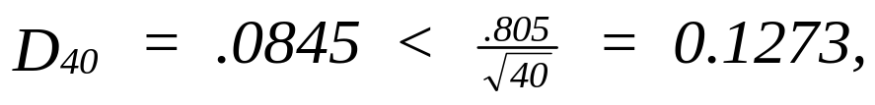
Case 3: Preventive Maintenance
2. The MLE's were determined from the failure data -
with the result t_{MED} = 1938 and s = 0.84.
3. A lognormal distribution is now hypothesized and the
Lilliefors (K-S) goodness-of-fit test is conducted.
H0: Failure times are lognormal
H1: Failure times are NOT lognormal
MAX D1 8.453524E-02
MAX D2 5.705345E-02
K-S TEST STAT 8.453524E-02
SAMPLE SIZE 40

Slide 18
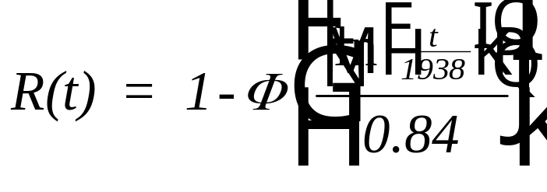
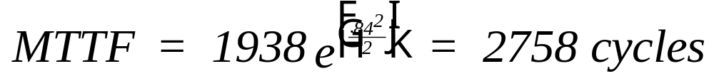
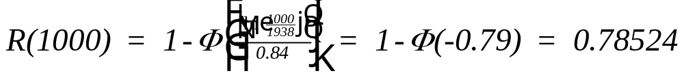
Case 3: Preventive Maintenance
4. The reliability function is:
5. To determine a preventive maintenance program designed
to meet the specification, the following table is constructed
using the model:

Slide 19
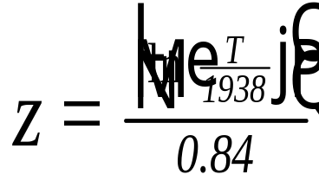
Case 3: Preventive Maintenance
n T R(T) R(T)^{n}
1 1000 -0.79 .78524 .78524
2 500 -1.61 .9463 .8955
4 250 -2.44 .99266 .9710
5 200 -2.70 .99653 .9827
8 125 -3.26 .99944 .9955
6. Therefore, a 200 cycle preventive maintenance program is
suggested (initiated).

Slide 20
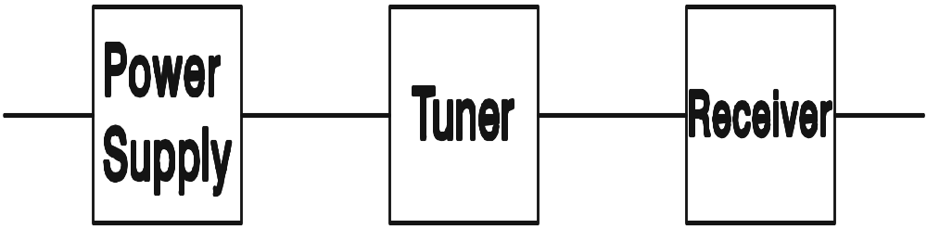
Case 4: Reliability Allocation
A reliability testing program conducted during initial development tested each component independently with the following results. The test was concluded after 8000 operating hours (accelerated life testing). From the test data, the engineering design team must determine the number of redundant components in order to achieve a 95 percent reliability at 1000 operating hours.

Slide 21
Case 4: Reliability Allocation
Power
Supply Tuner Receiver
Unit Cost ($) 175 250 525
Number on Test 30 20 15
Failure Times: 4779 588.0 82.8
5051 3682.6 820.2
5633 3819.0 858.3
6317 4999.5 1201.9
7491 5048.3 1412.3
7573 5688.1 1989.1
7637 7480.7 2042.7
7953 7641.6 3113.9
3176.6
3706.7
3790.3
4057.0
4488.0
t* = 8000 hours

Slide 22
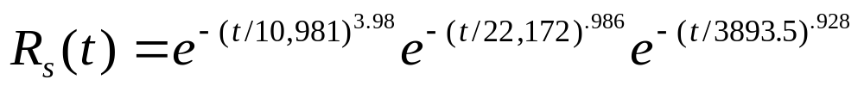
Case 4: Reliability Allocation
Because the data was incomplete (Type I censored), a
least-squares fit using the Weibull probability-plot was
accomplished with where n is the total number on test.
Summarizing the results:
Power Supply Tuner Receiver
Estimated β 3.98 0.986 0.928
Estimated θ 10981 22172 3893.5
Correlation 0.95 0.93 0.95

Slide 23
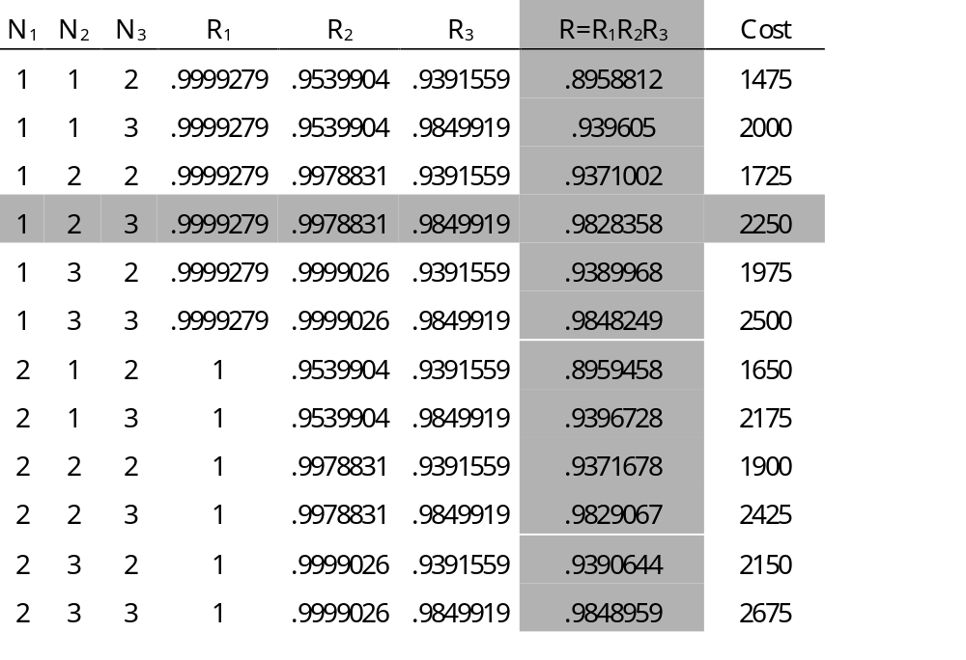
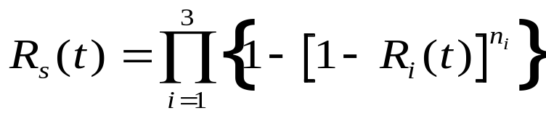

Slide 24

Case 5: Reliability Growth Testing
A high priced automobile will have a new road sensing suspension system with four linear vertical displacement sensors. The sensors provide a controller with information on the dynamic state of the vehicle. Prior to production, prototype sensors are to undergo reliability growth testing in order to reach a target MTTF of 8000 hours. Testing consists of measuring electrical performance (operating current, output impedance, voltage), determining the effect of various (accelerated) environmental stresses including
temperature, temperature cycling, humidity and water spray, corrosion and salt spray, and dust; and subjecting the sensors to (accelerated) mechanical vibration tests.

Slide 25
Case 5: Reliability Growth Testing
Initial test were performed on 43 sensors with 6 failures
occurring at individual test times of 24, 72, 102, 168, 216, and
250 hours. Each failure was analyzed with the design team
recommending and implementing design corrections. The test
plan required terminating the test at 300 hours.
Failure time Cumulative Test Time
24 43 x 24 = 1032
72 1032 + 42 x(72-24) = 3048
102 3048 + 41 x (102 - 72) = 4278
168 4278 + 40 x (168 - 102) = 6918
216 6918 + 39 x (216 - 168) = 8790
250 8790 + 38 x (250 - 216) = 10,082
Total test time (Type I) = 10,082 + 37 x (300-216) = 11,932 hr.

Slide 26
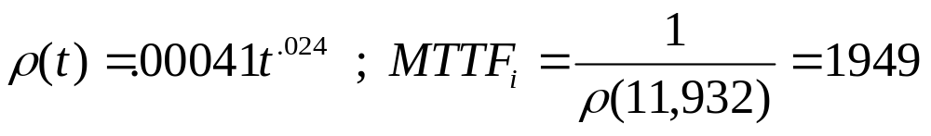
Case 5: Reliability Growth Testing
Failure time Cumulative Test Time
24 43 x 24 = 1032
72 1032 + 42 x(72-24) = 3048
102 3048 + 41 x (102 - 72) = 4278
168 4278 + 40 x (168 - 102) = 6918
216 6918 + 39 x (216 - 168) = 8790
250 8790 + 38 x (250 - 216) = 10,082
Total test time (Type I) = 10,082 + 37 x (300-216) = 11,932 hr.
AMSAA GROWTH MODEL - MLE PARAMETER ESTIMATES
b = 1.024 a = .0004

Slide 27
Case 5: Reliability Growth Testing
In order to establish growth targets, the idealized growth curve was used.
The growth parameter, a = .58, was computed with MI = 11932/6 = 1988, MF = 8000, t1 = 11932 » 12000 , and T = 36000 hours.
The total cumulative test time of 36,000 hours was based upon
the resources available and the time remaining to complete development of the sensor.
A growth rate of .58 resulted in M(36000) = 8951.
Therefore the growth parameter was adjusted downward to
a = .55 resulting in M(36000) = 8083 hours.

Slide 28
Case 5: Reliability Growth Testing
Using the idealized growth curve, milestone targets were
computed at 6000 hour increments giving:
Cum Test Time M(t) Cum Failures Average (interval) MTTF
18,000 hrs 5521 7.24 4966
24,000 6468 8.24 5992
30,000 7312 9.11 6889
36,000 8083 9.9 7697

Slide 29

Case 6: Repairable System
The Notso Reliable Manufacturing Company has been
experiencing a high number of failures with its five year
old industrial robot used for arc welding. Once the unit
fails it is often down for what is considered to be an
excessive length of time for repair. Downtime costs the
company $750 per failure in lost production and repair costs.
A replacement unit will cost $21,000. The company wishes
to determine if it is economical to replace the unit. The unit
was advertised as having a 10 year design life. The unit
operates 8 hours a day for 240 days out of the year (total
operating hours 1920 a year).

Slide 30
Case 6: Repairable System
From the time the robot was first installed, the Company has
recorded the following failure times of the unit in
operating hours:
1339 1857 2307 3329 3792 3891 5541 5646 5726 5806 6530 6736 6771 6826 7056
7065 7097 7771 7779 7942 8045 8088 8558 8642 8764 8958 9034 9104 9318 9523
For the last 16 failures, they have also maintained a log of the
following repair times in hours:
36.2 47.7 81 7.2 36.1 2.7 4.5 27.6 5.2 7.2 16.7 26.8 7.7 12.6 8.4 10.8

Slide 31
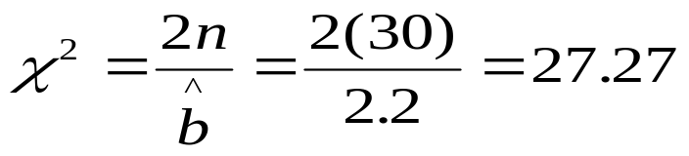
Case 6: Repairable System
Because of apparent decrease in times between failures over the five years, a nonhomogeneous Poisson process (NHPP) is hypothesized with a power law intensity function. Maximum likelihood estimates were obtained from the above failure data with the result:
Since the estimate for b > 1, the system is deteriorating.
The test statistic for trend is
with 58 degrees of freedom.
The critical chi-square values at the ten percent level of
significance are approximately 43.2 and 79.1. Therefore the
null hypothesis of no trend in the data is rejected.

Slide 32
Case 6: Repairable System
The Cramer-von Mises goodness of fit statistic was computed and found to be CM = .0616 with M = 29 (failure terminated data). Since the critical value is .128 at a 20 percent level of significance, the power law intensity function was accepted as a good fit to the data.
1. A least squares fit of the repair times to the exponential, Weibull, normal and lognormal resulted in the lognormal having the highest R² value of .976
2. The MLEs for the lognormal distribution were then computed with t_{med} = 13.8 and s = .93 giving a MTTR of 21.3 hours and a standard deviation of 25.0 hours.
3. The (KS) goodness-of-fit statistic for the lognormal distribution is D₁₆ = .14 which is less than the ten percent critical value of .195. Therefore the null hypothesis that the repair times came from a lognormal distribution is accepted.

Slide 33
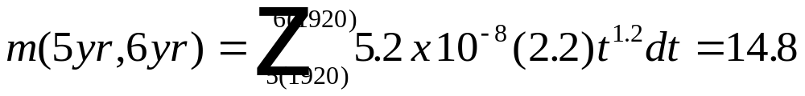
Case 6: Repairable System
At the five year point (9600 operating hours), the unit will have an instantaneous MTBF of
1/[5.2 x 10-8 x 2.2 x 96001.2 ] = 145.5 hours.
If no further deterioration is observed, a steady-state availability of 145.5 / [145.5 + 21.3] = 87% will be obtained.
E [TC] = $750 (14.8) = $ 11,100
E [downtime] = 14.8 (21.3) = 315 hr (8 work weeks)

Slide 34
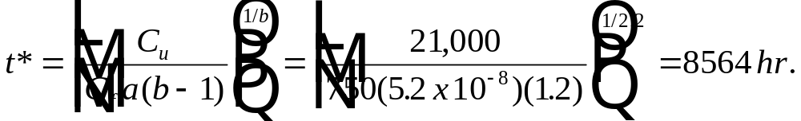

Case 6: Repairable System
Using the optimal replacement model:
The answer is obvious now.
We must replace the robot.

Slide 35
Case 7: Multiply Censored Data
The following are failure or censored times (in hours) for
twenty machine dies all manufactured by the same company.
Censored times resulted from dies which were no longer used
because of design or manufacturing changes.
15+, 118, 260+, 323+, 518, 531+, 642+, 758, 824, 882, 1324, 1583 1795, 1853+, 2556, 2829, 5003, 6299, 13990+, 18790
These dies were advertised by the manufacturer as having
a 500 hour design life (with a 90 percent reliability). The
company wants to determine if the advertised design life
is being met before it decides to order additional dies from
this manufacturer.

Slide 36
I TIME RANK INCR ADJ RANK RELIABILITY
1 16 +
2 117 1.05 1.05 .9632353
3 261 +
4 323 +
5 518 1.173529 2.223529 .9057093
6 531 +
7 643 +
8 758 1.341177 3.564706 .8399654
9 824 1.341177 4.905882 .7742215
10 881 1.341177 6.247059 .7084775
11 1323 1.341177 7.588235 .6427336
12 1582 1.341177 8.929412 .5769896
13 1795 1.341177 10.27059 .5112457
14 1854 +
15 2556 1.532773 11.80336 .4361098
16 2829 1.532773 13.33613 .3609738
17 5002 1.532773 14.86891 .2858379
18 6298 1.532773 16.40168 .210702
19 13991 +
20 18789 2.29916 18.70084 9.799804E-02

Slide 37
(1) LEAST-SQUARES PROBABILITY PLOT FOR EXPONENTIAL
SLOPE - FAILURE/REPAIR RATE 1.540163E-04
L-S ESTIMATE OF MEAN 6492.821
R-SQUARED .6573834
(2) LEAST-SQUARES PROBABILITY PLOT FOR WEIBULL
INTERCEPT - A -7.358218
SLOPE - B .8889475
ESTIMATED BETA .8889475
ESTIMATED THETA 3934.144
R-SQUARED .9367709
(3) LEAST-SQUARES PROBABILITY PLOT FOR NORMAL
INTERCEPT - A -.6514274
SLOPE - B 1.307285E-04
ESTIMATED SIGMA 7649.442
ESTIMATED MEAN 4983.057
R-SQUARED .5631521
(4) LEAST-SQUARES PROBABILITY PLOT FOR LOGNORMAL
INTERCEPT - A -5.190266
SLOPE - B .6729616
ESTIMATED S 1.485969
ESTIMATED Tmed 2236.291
R-SQUARED .9667019

Slide 38
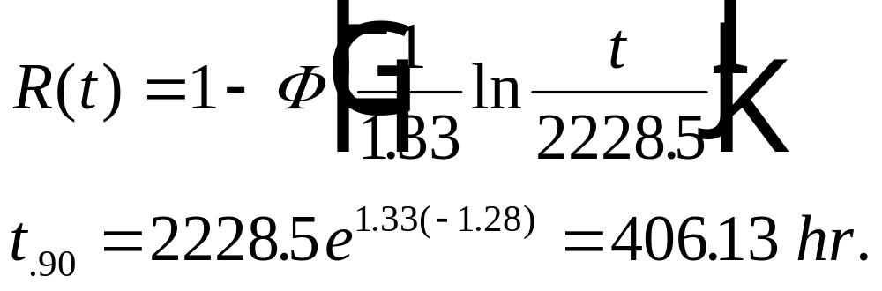

Case 7: Multiply Censored Data
The MLEs for the lognormal were found to be t_{med} = 2228.5
and s = 1.33.
We need to order our
dies from a more reliable
company.

Slide 39
Case 8 Multiple Failure Modes
A high altitude, medium endurance, unmanned reconnaissance and surveillance aircraft is under development by a large defense contractor.
The vehicle consists of four primary subsystems –
  propulsion which includes the fuel components;
  structures which include the fuselage, wing, tail, control surfaces, and landing gear;
  electrical which includes the fly-by-wire assembly;
  and avionics which includes communication, navigation, and electro-optics.
It is expected to have an average mission duration of 5 hours.
Reliability specifications require 0.90 reliability at 80 operating hours (16 missions).

Slide 40
Case 8 Multiple Failure Modes
Twenty-four prototypes of each subsystem have been developed specifically for use in reliability life testing. Each subsystem has independently undergone considerable reliability testing by the contractor with the results provided below. All units tested either “ran to failure” or were terminated after 1000 test hours had elapsed.
Failure Number | Propulsion | Structures | Electrical | Avionics
1 | 142 | 1 | 142 | 2
2 | 492 | 2 | 168 | 4
3 | 500 | 7 | 202 | 20
4 | 501 | 29 | 207 | 63
5 | 572 | 40 | 210 | 69
6 | 622 | 45 | 259 | 74
7 | 645 | 64 | 274 | 87
8 | 670 | 93 | 275 | 125
9 | 674 | 120 | 289 | 177
10 | 683 | 200 | 290 | 222
11 | 705 | 263 | 302 | 267
12 | 805 | 304 | 308 | 286
13 | 826 | 322 | 314 | 305
14 |  | 582 | 345 | 391
15 |  | 594 | 345 | 466
Partial
Data
Set

Slide 41
Case 8 Multiple Failure Modes
Failure distributions were determined for each failure mode with the data in all cases being type I censored with a termination time of 1000 hours. The R² value from a least-squares analysis was the bases for selecting the most appropriate distribution.
Subsystem | Distribution | Least-squares Parameter Estimates | R² | MTTF
Propulsion | Normal | μ = 822.4, σ = 314.2 | .902 | 822
Structures | Weibull | θ = 689.3, β = .501 | .992 | 1373.5
Electrical | Lognormal | t_{med} = 317.7, s = .406 | .989 | 345
Avionics | Exponential | λ = 0.00201 | .987 | 496.3

Slide 42
Case 8 Multiple Failure Modes
 | normal | weibull | lognormal | exponential
 | μ =822.4 | β = 0.501 | S =0.406 | λ = 0.00201
 | σ =314.2 | θ =689.3 | t_{med} = 317.7
Time | Propulsion | Structures | Electrical | Avionics | R(t)
10 | 0.995144 | 0.886977 | 1 | 0.980052 | 0.865062
20 | 0.994676 | 0.84389 | 1 | 0.960502 | 0.806243
30 | 0.99417 | 0.812236 | 1 | 0.941342 | 0.760134
40 | 0.99362 | 0.786466 | 1 | 0.922564 | 0.720937
50 | 0.993026 | 0.764435 | 0.999997 | 0.904161 | 0.68635
60 | 0.992383 | 0.745046 | 0.99998 | 0.886125 | 0.655161
70 | 0.991688 | 0.727646 | 0.999902 | 0.868449 | 0.62661
80 | 0.990939 | 0.711815 | 0.999656 | 0.851125 | 0.600147
90 | 0.99013 | 0.697257 | 0.999047 | 0.834147 | 0.575326
100 | 0.98926 | 0.683761 | 0.997781 | 0.817508 | 0.551749
110 | 0.988324 | 0.671166 | 0.995481 | 0.8012 | 0.529057

Slide 43
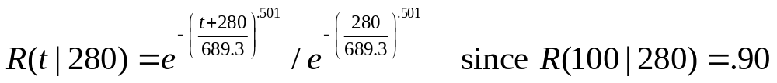
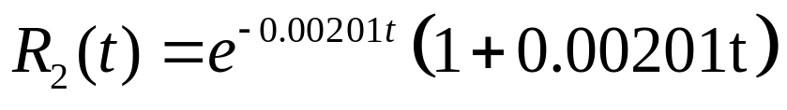
Case 8 Multiple Failure Modes
All actuators and landing gear hydraulics components will now undergo factory burn-in testing in order to achieve 90 percent reliability at 100 operating hours. Any units that fail during burn-in will be sent back for rework. Using Eq. (13.6), a 280 hour burn-in period was determined. The resulting reliability model for structures is
For those avionics components that are generating the subsystem failures, a standby redundant component will be designed into the subsystem. Since the failure distribution of the subsystem is exponential, the standby redundancy can be modeled using Eq. (6.31):

Slide 44
Case 8 Multiple Failure Modes
Time (hr) | Propulsion | Structures | Electrical | Avionics | R(t)
10 | 0.999717 | 0.98877 | 1 | 0.999801 | 0.988293
20 | 0.99967 | 0.977854 | 1 | 0.999213 | 0.976761
30 | 0.999614 | 0.967236 | 1 | 0.998252 | 0.965173
40 | 0.999551 | 0.9569 | 1 | 0.996933 | 0.953537
50 | 0.999477 | 0.946832 | 0.999997 | 0.995272 | 0.94186
60 | 0.999393 | 0.937019 | 0.99998 | 0.993281 | 0.930139
70 | 0.999297 | 0.927448 | 0.999902 | 0.990975 | 0.918341
80 | 0.999186 | 0.918108 | 0.999656 | 0.988368 | 0.906378
90 | 0.999059 | 0.90899 | 0.999047 | 0.985471 | 0.894088
100 | 0.998915 | 0.900082 | 0.997781 | 0.982298 | 0.881229
110 | 0.998751 | 0.891375 | 0.995481 | 0.978861 | 0.867504
120 | 0.998564 | 0.882863 | 0.991722 | 0.975171 | 0.852589

Slide 45
Case 9: Availability
Bob Best manufacturers a special lithium ion (Li-ion) rechargeable battery for the government.
These batteries are sold to Homeland Security which uses them to power remote sensors. These sensors are designed to detect the presence of terrorists in isolated regions of the country.
Each battery must be recharged every 90 days. Average time to recharge a battery is one-half day which includes removal, recharge time, reinstallation, and check-out. The sensors are not operating during this period of time.
Homeland Security originally purchased 126 of Bob’s best batteries

Slide 46
Failure Data – after slightly more than 5 years (exactly 1,840 days), the following failures were observed with the failure times given in days.
0.6 16.3 76.3 215.2 348.6 454.2 897.7 1677.7 1.2 20.1 79.9 219.0 352.8 528.2 925.9 1833.9 1.4 24.0 85.5 222.4 363.7 559.9 1002.2 1.7 24.6 97.1 256.8 370.2 564.1 1003.0 3.6 26.7 98.1 259.8 373.6 583.7 1035.3 4.2 27.8 108.8 263.2 374.7 594.3 1149.0 4.7 29.3 123.0 272.3 382.8 622.1 1168.5 5.2 29.4 123.9 272.3 386.6 711.8 1202.7 10.9 33.8 124.0 272.4 397.9 731.3 1256.3 11.9 35.2 131.8 278.8 401.9 792.1 1284.2 12.0 44.3 135.7 301.8 409.0 798.1 1320.3 12.2 47.9 154.0 302.3 421.3 813.9 1569.8 12.3 55.4 159.0 342.1 423.1 818.1 1582.0 13.3 66.0 181.9 345.2 425.1 821.6 1589.6 15.8 75.9 204.8 345.7 445.6 871.2 1630.9
The remaining units are still operating (Type I censored data)

Slide 47
Replacement times in days
0.3 0.7 0.6 2.8 0.5 1.3 0.6 0.9 1.3 2.8 5.4 2.4 23.1* 3.1 3.9 1.3 1.6 4.5 4.1 0.7 4.4 1.9 0.6 0.9 4 2.4 0.3 32.2* 22.7* 0.3 6.5* 2.8 3.2 1.8 4.5 13.9* 1.8 1.1 2.9 0.9 1.1 1.6 0.4 1.3 3 5.5* 0.4 3.5 2 1.6 3.5 11.2* 2.7 1.9 0.8 1.9 3 3.7 5.1 1.1 0.2 9.9 1 5.7 7.1 8.8* 0.1 0.8 3 0.6 2.4 0.9 0.3 8.9* 17.3* 0.5 3.5 1.5 2.7 3.6 0.8 1.1 1.2 1.6 1.1 0.3 0.2 5.5* 1.8 1.1 6.6 2.7 1 0.9 0.1 6.4 0.8 0.9 4.1 0.4 3.2 0.7 0.1 2 0.2 2.5 0.4

Slide 48
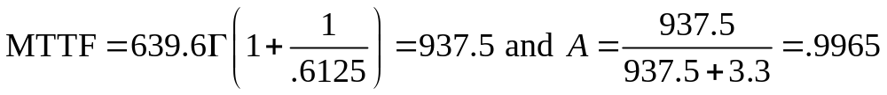
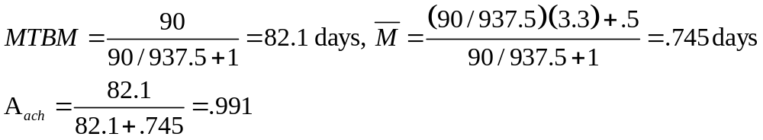
Case 9: Availability
Using the chi-square GOF test, the best fit failure distribution is Weibull with θ = 639.6 days and β = .6125. The best fit repair distribution is the exponential with a MTTR = 3.3 days. Assuming a renewal process the inherent availability is determined from

